Slide 1

DIGITAL MARKETING PROJECT PHASE2
Comprehensive Digital Marketing Hero Moto Crop LTD

Slide 2

PRESENTED BY
TEAM MEMBERS:
V.TULASI
P.POOJITHA
O.DINESH
G.SAI KUMAR
FACULTY GUIDE: SK.ZELANI SIR

Slide 3
CONTENT OF THE PROJECT INDEX
SL NO | PARTICULARS
Chapter 1 | Brand Study, Competitor Analysis &Buyer`s\Audience`s Persona
Chapter 2 | SEO & Key Words Research
Chapter 3 | Content Creation And Marketing Strategies
Chapter 4 | Content Creation And Curation
conclusion | Conclusion of the Project

Slide 4

BRAND STUDY,COMPETITOR ANALYSIS & BUYERS\AUDIENCE’S PERSONA
RESEARCH BRAND IDENTITY
COMPETITOR ANALYSIS
BUYER’S\AUDIENCE’S PERSONA

Slide 5
RESEARCH BRAND IDENTITY
vision/mission
Hero MotoCorp’s Ltd.., company own identity reflects its commitment Towards class mobility solutions with focus on expanding company’s footprint in the global area.
Hero MotoCorp machine is to become a global enterprise fulfilling its customer needs and setting benchmarks in technology.
COMPETITOR ANALYSIS
The top competitors of Hero MotoCorp include Athar Energy, TVS Motor company, Ultra Violette, Ampere vehicle's and Damon.

Slide 6
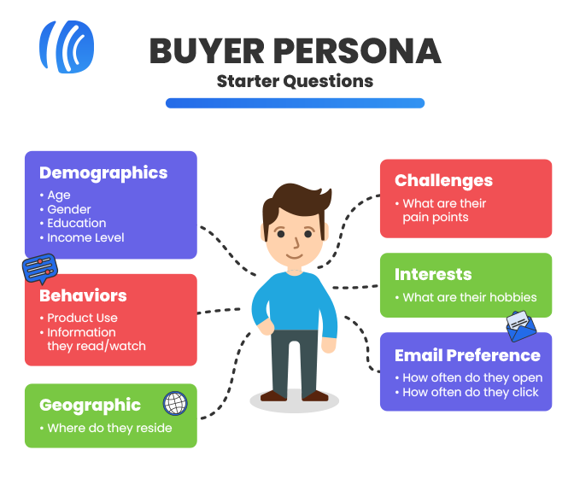
BUYER’S\AUDIENCE PERSONA

Slide 7
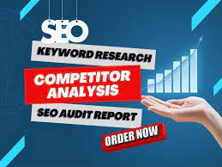
CHAPTER - 2
SEO & KEYWORD RESEARCH
SEO Audit
Keyword Research
On page optimization

Slide 8
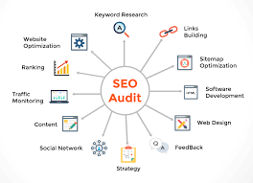

SEO AUDIT AND KEYWORD RESEARCH
SEO AUDIT
KEYWORD RESEARCH
It is the process of evaluating how well your website is optimized for searching engines.
It is the process of finding keywords user by user for making a search of particular piece of information.

Slide 9
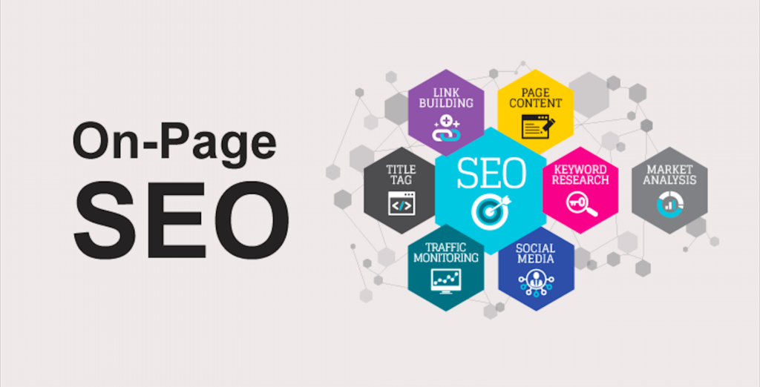
ON PAGE OPTIMIZATION
It refers to all the measures
That can be taken directly
Within the website in order
To improve its position in
The search rankings.

Slide 10

CONTENTS IDEAS AND MARKETING STRATEGIES
Content idea generation and strategies
Marketing strategies

Slide 11
content ideas and marketing strategies
CONTENT IDEA GENERATION AND STRATEGIES
It involves exploring various topics with a brand goals and values that engaging , insightful with the target.
MARKETING STRATEGIES
The main 5p’s of MS
Product
Price
Promotion
Place
People

Slide 12
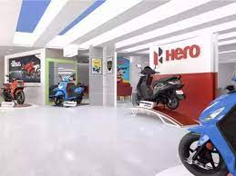
CONTENT CREATION AND CURATION
POST CREATION
DESIGNS OR VIDEO EDITINGS
SOCIAL MEDIA AD COMPAIGNS
EMAIL AD COMPAIGNS

Slide 13
CONTENT CREATION AND CURATION
POST CREATION
DESIGN OR VIDEO EDITING
HERO MOTOCORP LTD was established on JAN 19, 1984.
It was initially known as Hero Honda motor’s Ltd.
It was became an independent company after split with Honda.
For designs, we can use graphic design software's like Adobe photoshop, Illustrator, Canva to create visual graphics.
For video editing, software's like Adobe premiere pro, Filmora can be used

Slide 14
CONTENT CREATION AND CURATION
Social media AD campaign's
Email AD campaign's
Creating effective social media campaign's for Hero MotoCorp involves a strategic approach to engage the audience and promote the brand efficiency.
Creating an email AD campaign's for Hero MOTOCORP involves several steps to ensures its effectiveness.
Define our goals
Build a targeted Email list

Slide 15


